Slide 1
Build, release, run, repeat! DevOps at BPO IBX Business Network
Stefan Brönner, Dragos Metea, Niculae Vasile, Daniel Stoian

Slide 2












BPO IBX Business Network
ePurchasing Cloud pioneer since 2000
Rated as “Strong Performer” – Forrester 2014
Top-ranked procurement vendor – Gartner 2012
We envision “a world of connected businesses” …
… and we intend to realize it by “making procurement everybody's business”
Two data centers, 800 servers, 50+ applications under management, 24x7x365
+325
buying customers
Legally invoice compliant in
+40
countries
550,000
suppliers
Products operated in
+140
countries
$25 billion
in managed spend
25,000
sourcing events

Slide 3

BPO IBX Business Network – Two years of Devops in a nutshell
People
It is all about the right people with the right skillset and the right attitude! People are much more important than process or technology You need a culture shift! Be prepared to change your people if necessary
Automation tool chain
Use a chain of best-in-breed tools Use open source tools – just like Amazon and Facebook Our toolchain: Chef, Rundeck, Jenkins, Scripting Languages, vSphere You don’t need to pay licenses to get started
Process
Agile is a MUST (Kanban, “fail quickly”) Deliver Infra and Ops as Code Incremental change – No big bang required! DevOps strengthens ITIL (e.g. Change Management) DevOps is great for compliance!
Transformation
What matters is the running service – not software, nor infrastructure! Tear down the silos! Invest in people first Result: Reduced cost (FTEs) by 30% in 2014 with better SLAs while doing a lot more!

Slide 4
What is the
Product
that BPO IBX Business Network is delivering?

Slide 5

What is it the Customers are actually paying for?
The customers are paying for a running service
If the service isn’t running, there is no product or business
Operations is our “factory floor” and “storefront”
Everything else is a “parts supplier” (including Developers)
Everybody has its own set of requirements that need to be part of the service
The running service is the product!

Slide 6
Running the Service requires tight interaction between different groups
Development & Quality Assurance
Product Management
Operation & Infrastructure

Slide 7
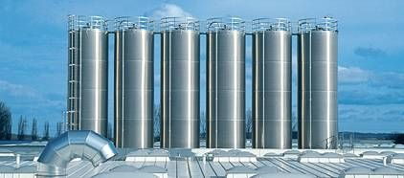
Why is this not working so well? Each group is a silo!
Product management
Development
Operational

Slide 8
Two years ago we decided to transform our organization and to tear down the
silos!

Slide 9

Increased speed, lower cost and better SLAs!
One Delivery Team (Product Management, Dev, QA, Operations, Infrastructure)
Applying Development best practices to Operations and Infrastructure
Replacing manual process with automation
Eliminating human errors and waste
Operations and Infrastructure as code
Infrastructure independence (deploy everywhere)

Slide 10
Enterprises are raving about DevOps:
“The agile, perfect fusion between the IT operations and development departments. Using one unified, highly automated ‘train’ of tools, DevOps teams develop applications, test and integrate them, package them for deployment and bring them live in a continuous, uninterrupted flow. Not once a month, not even once a week but – if necessary – repeated many times a day.”
From Capgemini Techno Vision 2015
Released November 6th, 2014

Slide 11
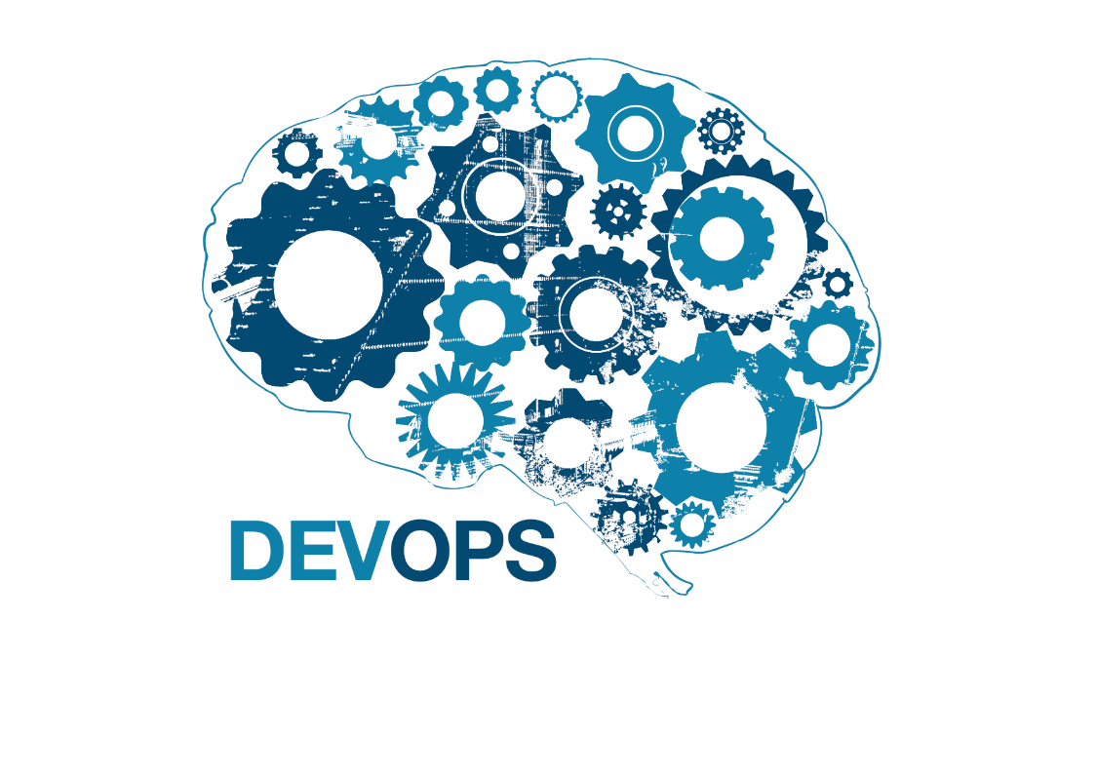
DevOps is
A Culture Shift
Not A Technology

Slide 12
What it is not:
A tool you can buy
Hard & fast rules
Run by one group
A big bang project
A set of technologies
What it is:
A concept
A set of best practices
An integrated organization
An incremental change
A way of working

Slide 13
Incremental change – One application at a time
Level 0
Configuration Management in place
Level 1
Provisioning of Virtual Machines
Level 2
Application Prerequisites
Level 3
Level 4
Application Deployment
Automated Operations
Iterative approach – no big bang is required!
Concept of automation levels
Each application is transformed from level 0 to level 4
Each level builds on the previous level and adds more value
Level 3 creates the most value

Slide 14
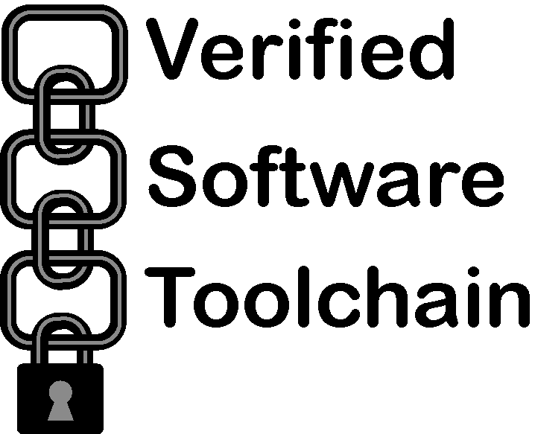
The DevOps Tool Chain for Automation
A chain of open-source tools is used for automation - Not a big monolithic solution
The vast majority of tools are open source but commercial support is available
We are standing on the shoulder of giants – most tools are already used by organizations like Facebook, Salesforce, eBay or Amazon
Primary tools used: Subversion, Jenkins, Rundeck, Chef

Slide 15
Case Study: IBX Shop
Before
Deployment of solution: 6h
Creating a new environment (e.g. for testing): 4 weeks
SLA: <99,4%
Knowledge restricted to one critical resource
Static documentation
After
Deployment of solution: 3h
Creating a new environment in 6 hours
SLA: >99,6%
Knowledge spread along a team
Dynamic configurations

Slide 16


What we achieved until now
No more silos!
14 applications up to Level 4
9+ applications up to Level 3
6 experienced DevOps practitioners
7 infrastructure processes automated
All applications on Level 3+ can be deployed on any cloud infrastructure

Slide 17
What we achieved in 2014
January
2014
20 FTE in Operations team
December
2014
16 FTE in Operations team
38 manual applications
Deployments in production
6 automated applications
Deployments in production
27 manual applications
23 automated applications
44 Applications
50 Applications
13 FTE in Infrastructure team
10 FTE in Infrastructure team
8+ manual processes
15+ manual processes
7 automated processes
0 automated processes

Slide 18
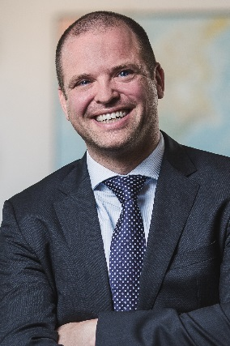
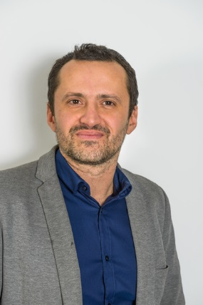
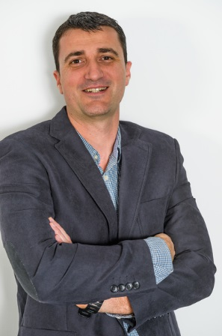
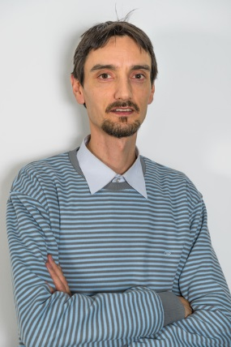
Contact information
Insert contact picture
Stefan
Brönner
CTO IBX Business Network stefan.broenner@capgemini.com
Insert contact picture
Dragos Metea
Technology Manager
dragos.metea@capgemini.com
Insert contact picture
Niculae
Vasile
Application Operations Manager
niculae.vasile@capgemini.com
Insert contact picture
Daniel
Stoian
DevOps Team Lead
daniel.stoian@capgemini.com

Slide 19
Suggested Further Readings
Capgemini Techno Vision 2015: Build, release, run, repeat!
Damon Edwards from Rundeck on Dev "Programming" Ops for DevOps Success” (SlideShare)
The Rise Of Coded Business (Chef)

